Slide 1
using ANN
Sound based emergency vehicle detection
using
convolutional neural networks
17121A1591- RAMISETTY CHANDANA
17121A1581- PENDELA KAVYA SREE
17121A15A2- SAYA NAVYA
17121A15B5- VEMPALLI SALMA
Batch No: 14
Name of the guide: Mr.Giridhar
Date of Review: 07/04/2021

Slide 2
Emergency Vehicle Detection using ANN
CONTENT
INTRODUCTION
LITERATURE REVIEW
METHODOLOGY
PRELIMINARY DATA
STATEMENT OF LIMITATIONS
CONCLUSION

Slide 3
INTRODUCTION
One of the many problems that the world is currently experiencing with increased population and rapid growth is traffic congestion.
In countries such as India, the rate of road expansion is just one-third the vehicular growth rate. Statistics show that the current annual growth of vehicles is around 11% while the annual road extension remains to be only around 4%, thus making it impossible to create a separate lane for emergency vehicles.
The timer based traffic system is suitable only for light traffic which uses a predefined time setting for its processing. For heavy traffic system, an adaptive system is required which could manage the traffic density.

Slide 4
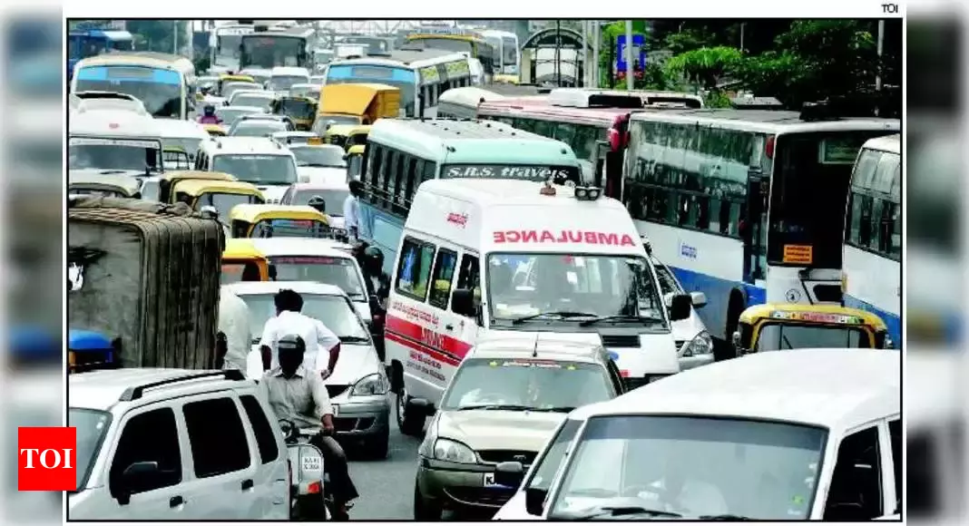
Emergency Vehicle Detection using ANN
The main drawback of generalized traffic control system is high priority situations and emergency conditions are difficult to detect. This urges the need of smart traffic control system to make it suitable to handle all conditions and to take decisions automatically.
Emergency vehicles, like ambulances, fire trucks etc are the most affected ones due to traffic congestions. A good traffic management system is required to prevent such issues and our system is designed to complement this.

Slide 5
Emergency Vehicle Detection using ANN
One of the major problems faced by heavy traffic is by ambulances. Due to heavy traffic, one can often see the ambulances stuck in traffic for long durations thus causing danger to patient’s life. As the number of road users constantly increases, and resources provided by current infrastructures are limited, intelligent control of traffic will become a very important issue in the future.
According to a report published by Times of India about 146,133 people were killed in road accidents in India in the year 2016. Unfortunately about 30% of deaths are caused due to delayed ambulance. Another Indian government data shows more than 50% of heart attack cases reach hospital late , which can constitute unavailability of ambulances too but majority of it is due to patients stuck in traffic.

Slide 6
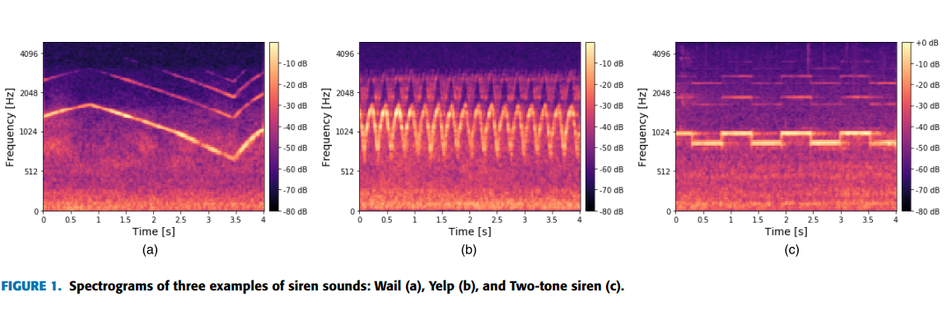
LITERATURE REVIEW
Till now, there are only a few studies on the recognition of siren sounds, such as J. Liaw proposed to recognize the ambulance siren sound in Taiwan by the Longest Common Subsequence (LCS) .Such an LCS-based system yielded an accuracy of 85% on a small dataset.
MFCC was used together with multi-layer neural networks to detect the siren sounds through the voting method. The system in relatively met the need of low-computational complexity, but it lacked analysis on a diverse dataset

Slide 7
There is no efficient method to recognize and transport emergency vehicles in the least possible time.
the objective is to avoid the ambulance and other emergency vehicles waiting in traffic by automatically clearing the track of the vehicle from traffic blocks and signals. by providing a system which can reduce the risk of life of the person in the vehicle by identifying the vehicle on road by means of sound recognition.
We aim to solve this problem using Audio fingerprinting and CNN, a technique to identify types of sound pattern by comparing them with available samples of similar patterns.
This will be done by manipulating the traffic signals based on audio of an emergency vehicle present in the signal which will be detected using its distinctive siren sound.
The distinctiveness of the siren sounds will be used for the audio fingerprinting purpose.

Slide 8
[1] T. Naik, Roopalakshmi R., Divya Ravi N., P. Jain, Sowmya B. H., Manichandra. “RFID-Based Smart Traffic Control Framework for Emergency Vehicles”. Proceedings of the 2nd International Conference on Inventive Communication and Computational Technologies (ICICCT), 2018. | a RFID-based system which manages and regulates the traffic signals at junctions when the emergency vehicle approaches, by allowing the easy passage out of the traffic congestions
[2] Shuvendu Roy, Md.Sakif Rahman “Emergency Vehicle Detection on Heavy Traffic Road from CCTV Footage Using Deep Convolutional Neural Network”, International Conference on Electrical, Computer and Communication Engineering (ECCE), 2019 | an automated system to detect emergency cars from CCTV footage using the deep convolutional neural network

Slide 9
[3] Dinesh Rotake & Prof. Swapnili Karmore. “Intelligent Traffic Signal Control System”, International Journal of Computer Science and Application(TIJCSA), 2012 | system uses IR sensors, AVR-32 microcontroller with programmable flash memory and built in 8-channels ADC. IR sensor is programmed to detect emergency vehicle and microcontroller is designed to give red signal to all other lane but one with emergency vehicle.
[4] Shruthi K R and Vinodha K. “Priority Based Traffic Lights Controller Using Wireless Sensor Networks”, | Wireless Sensor Network is being used as communication infrastructure. System uses fuzzy logic to define direction of emergency vehicle. Central monitoring system collects all information and gives appropriate response.

Slide 10
METHODOLOGY
ACOUSTIC-BASED EVD USING CNN:
Cnn For Audio Recognition:
CNN has recently been employed for audio recognition problems successfully, such as in music tagging, environmental/urban sound classification and automatic speech recognition.
The two well-known image recognition networks, Alexnet and GoogLeNet, for classifying environmental sounds are trained on audio’s image-based representations, including spectrogram and MFCC.
CNN is partially similar to conventional deep neural networks, but it uses additional layers, namely convolutional layers and pooling layers, instead of only using a series of fully-connected layers. A CNN in classification task contains two major components: feature learning and classification.
B. SirenNet: THE PROPOSED CNN-BASED ENSEMBLE MODEL
CNN-based ensemble model based on these two feature inputs like MFCCs and log-mel spectrogram and assessing the proposed model’s performance in classifying siren sounds, vehicle horns, and noises. Such an ensemble model is called SirenNet.

Slide 11
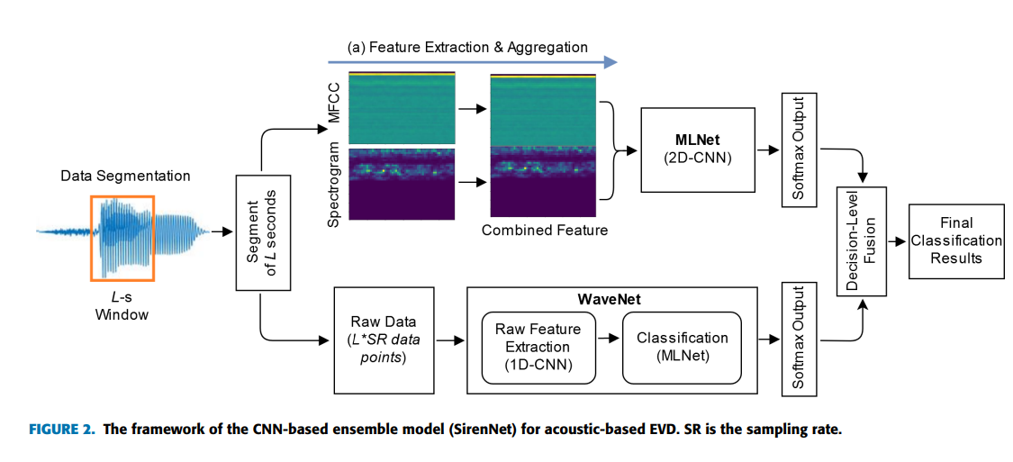
The proposed architecture consists of two parts: a 2D-CNN stream and a 1D-CNN stream, which are referred to as MLNet and WaveNet, respectively. The WaveNet works directly with raw waveform, while the MLNet is trained with aggregated features formed by image-based features (MFCC, and log-mel spectrogram). Then, the prediction results (softmax values) derived from MLNet and WaveNet are combined using the averaging method to make the final predictions.

Slide 12
Emergency Vehicle Detection using ANN
The Implementation of the project is carried out using python 3.1 and the following libraries are used:
PANDAS
TENSOR FLOW
LIBROSA
NUMPY
SCIKIT LEARN
MATPLOTLIB
SEABORN
KERAS

Slide 13
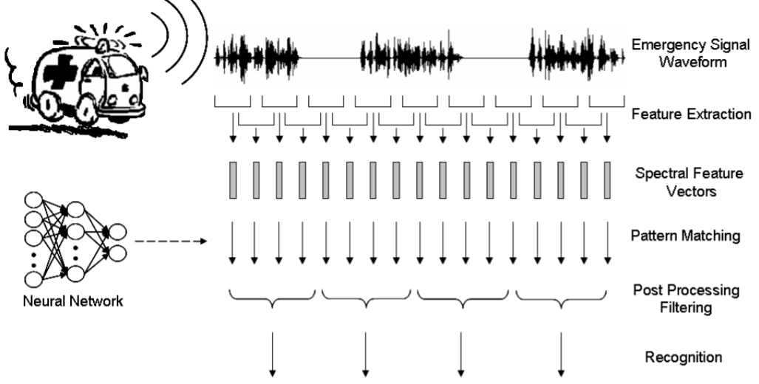
PRELIMINARY DATA
1. Pre-processing
Raw traffic audio from the microphone array is provided to the pre-processing module as input.
This module uses a sample of several different clear siren sounds as a secondary input.
Both inputs are converted to frequency domain from time-domain using the concept of fast Fourier Transform. Siren sounds are extracted and provided as input to the detection module.

Slide 14


Studying the audio signals
The study of audio signals involves analysis of signal, extracting its properties, predicting behavior, finding out if any specific pattern is present in the signal, etc.
From audio files we need to extract important features i.e. MFCCs, Spectral Centroid, Zero Crossing Rate, Chroma Frequencies, Spectral Roll-off.
The input audio signal has environmental sounds like vehicle horns, human noise, etc. along with siren sounds of emergency vehicles.
EMERGENCY SIGNAL
NON-EMERGENCY SIGNAL

Slide 15
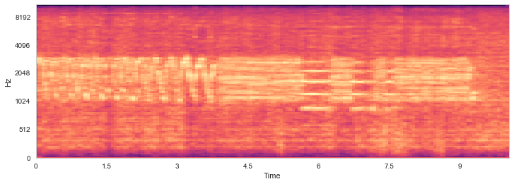
Feature extraction
The performance metrics of any Machine Learning algorithm depends on how accurately the expected features are extracted from the audio signals.
Feature extraction is required for classification, prediction, and recommendation algorithms. A few features like MFCCs, Spectral Centroid etc are extracted.
For our system, we have used MFCC (Mel-Frequency Cepstral Coefficient) based feature extraction as it is one of the most important and standard methods to extract features from audio signals. The MFCCs of a signal are a small set of features, which concisely describe the overall shape of a spectral envelope. It works by selecting energy in different frequency bands as the feature of the target.

Slide 16
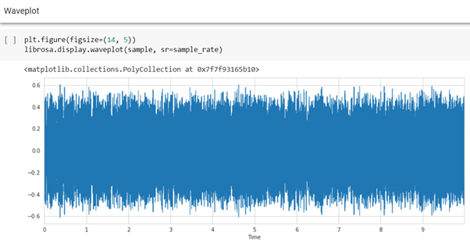
Emergency Vehicle Detection using ANN
Waveplot for siren sound

Slide 17
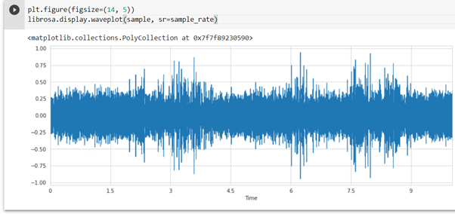
Emergency Vehicle Detection using ANN
Implementation Screenshots: Non Emergency
Waveplot for non siren sound

Slide 18
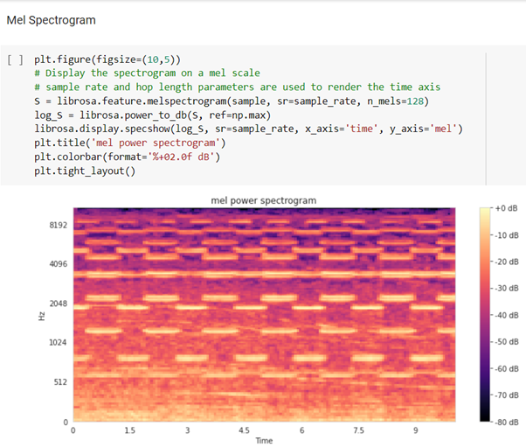
Emergency Vehicle Detection using ANN
Mel power spectrogram for siren sound

Slide 19
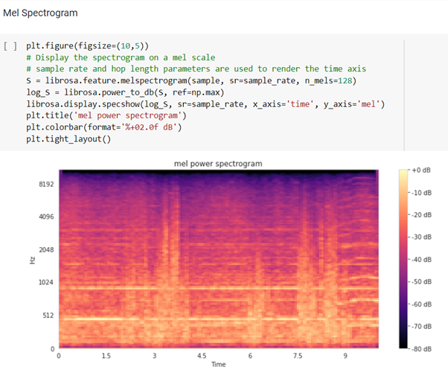
Emergency Vehicle Detection using ANN
Mel power spectrogram for non siren sound

Slide 20
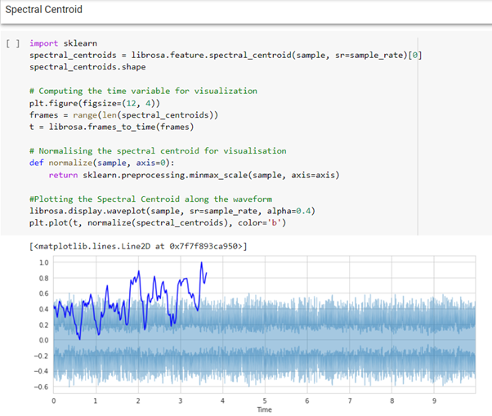
Emergency Vehicle Detection using ANN
Spectral Centroid for siren sound

Slide 21
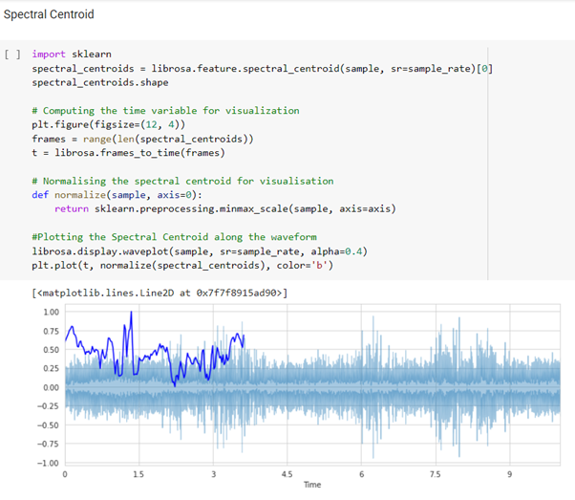
Emergency Vehicle Detection using ANN
Spectral Centroid for non siren sound

Slide 22
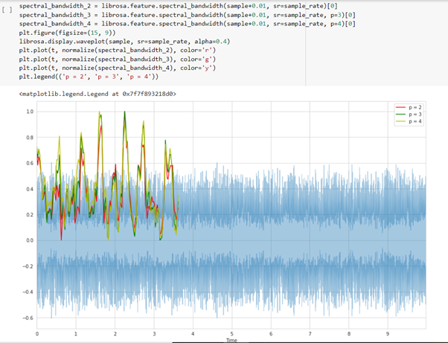
Emergency Vehicle Detection using ANN
Spectral Bandwidth for siren sound

Slide 23
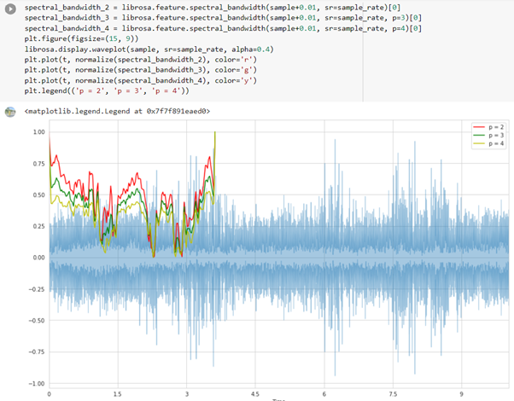
Emergency Vehicle Detection using ANN
Spectral Bandwidth for non siren sound

Slide 24
STATEMENT OF LIMITATIONS
Their limitations include:
The limitation of experimental data,
Imperfect performances
Stability of the systems was not thoroughly evaluated
RESEARCH ON:
To improve the above limitations by conducting comprehensive experiments on a larger dataset .
Our experimental dataset contains three sound classes of the siren, vehicle horn, and noise
Acoustic-Based Emergency Vehicle Detection Using CNNs various sampling rates, one or two channels, and coding in different bit-depth. Thus, the preprocessing stage is required to standardize our data so that it benefits the experimental process.
work is still needed to improve the detection performance and to meet the need for reliable and convenient emergency vehicle detection systems

Slide 25
CONCLUSION
Introduced a deep-learning model (SirenNet) based on convolutional neural networks for sirensound-based emergency vehicle detection. The proposed SirenNet is composed of two single CNN-based networks.
The importance of this system is to provide indication to drivers by detecting emergency vehicle siren sound and helps to clear traffic and to save life.

